Slide 1
Choosing Medicine as a Career
Danielle Gonzales, MS3
University of Colorado School of Medicine

Slide 2
My Path
Hometown: Born and raised in Denver, CO.

Slide 3
My Path
Hometown: Born and raised in Denver, CO.
College: Stanford University, BA in Human Biology 2010
Initially was an Economics major→ not for me
Did not know I wanted to go into medicine until Spring of my Junior year
Participated in various extracurricular activities related to medicine to decide if medicine was for me (I will get more into this later…)
Took 2 years off after college to finish requirements for medical school (more on this later as well…)

Slide 4
My Path
Hometown: Born and raised in Denver, CO.
College: Stanford University, BA in Human Biology 2010
Medical School: University of Colorado School of Medicine

Slide 5
So Why Go Into Medicine?
To make a positive impact on people’s lives/health
“Play detective”/solve puzzles
Enjoy learning about medical science
Personal experience with medical system/medical professionals
Lifelong learning
Enjoy working within a team
Job demand

Slide 6
Different Medical Professions
Profession | HS | Cert. | Train | College | Grad. School | Residency
CNA
MA
EMT
Paramedic
RN
NP
PA
Pharm D
MD

Slide 7
CNA
MA
Education:
Short training program (~160 hours)
Pass certification test
Responsibilities:
Feed, bathe, dress patients
Take vital signs
Answer calls for help
Monitor changes in patients behavior and condition
Minute to minute patient care
Education:
Training program (9-12 months for certificate or up to 2 years for associate’s degree)
Pass CMA certification exam
Responsibilities:
Administrative: update medical records, handle insurance forms and correspondence, scheduling, etc.
Clinical: collect lab specimens, perform basic lab tests, room patients and get preliminary information, etc.

Slide 8
EMT
Paramedic
Education:
Training program 2-6 months
Various levels of training ranging from 100-350 hours of training
Pass National Registry of Emergency Medical Technicians (NREMT) certification exam
Responsibilities
Provide urgent medical care to patients in the field
Work with police and firefighters at the scene and transport patients to medical facilities
Provide CPR, oxygen, vital signs, bandaging/splinting, basic airway management
Education:
2 year degree program in paramedic training
Many programs have a pre-requisite of college-level biology, math and English
Pass state licensing exam
Responsibilities:
More responsibilities, more job opportunities and higher salary than EMT (also requires more training)
Provide medications, endotracheal intubation (breathing tube), defibrillation, EKG monitoring, advanced airway management

Slide 9
RN
NP
Education:
Bachelor of Science in Nursing: 4 year program
Graduate school: 2 year program
Pass National Council Licensure Exam (NCLEX)-RN
Responsibilities:
Take patient’s medical history and symptoms
Assisting physicians during surgery or treatment
Explain home care procedures
Provide emotional support to families
Help with patient follow-up
Dispense medications
Education:
Obtain nursing degree
Complete a master’s degree program for NP: 2-4 years
Pass licensing exam
Responsibilities:
Mid-level provider
Can care for and develop patient care plans
Prescribe medications
All under the supervision of a physician
Typically in primary care, urgent care setting but there are other options

Slide 10
PA
Education:
4 year college degree
2-4 year PA program
Pass licensing exam
Responsibilities:
Mid-level provider
Have more flexibility in the specialties that they can go into

Slide 11
Pharm D.
Education:
4 year college degree
4 year Pharmacy program
Pass licensing exam
Responsibilities:
Community pharmacist: control, dispense and advise patients about their medications
Hospital pharmacist: participate in hospital rounds, monitor medications for patients and control which medications are dispensed and dosages

Slide 12
MD
Education:
4 year college degree
4 year MD program
Pass multiple licensing exams
Complete residency in your chosen specialty (3-7 years)
Can complete fellowship training to further specialize if desired
Responsibilities:
See patients and take comprehensive history and physical exam
Develop differential diagnoses for the various medical problems
Order labs and imaging and interpret results
Develop patient care plans
Correspond with other medical providers to coordinate care
Oversee PA and NP patient care

Slide 13
Other Medical Professions
Dentist
DO (osteopathic medicine)
Physical Therapist
Lab technician, etc.

Slide 14
Different Medical Professions
Educational Debt
Annual Income
CNA
$1,500 | $25,000
$4,000 | $30,000
$5,000 | $30,000
$8,000 | $30,000
$30,000 | $65,000
$50,000 | $90,000
$100,000 | $90,000
$200,000 | $190,000
MA
EMT
Paramedic
RN
NP
PA
MD

Slide 15
Road to Becoming A Doctor
High School
College
Medical School
Residency
Fellowship?
Attending

Slide 16
High School
College
Do the best you can do!
Study hard
Participate in extracurricular activities:
Sports, art, theater, music, whatever you enjoy doing
Volunteer
Have fun with medicine and get as much exposure as you can, enjoy it!
Shadow doctors/hospital
You can major in whatever you like:
Biology, Human Biology, English, Economics, etc.
Participate in extracurricular activities:
Same activities as high school
Research
Volunteer
Have fun with medicine and get as much exposure as you can, enjoy it!
Shadow doctors/hospital
Application process includes: personal statement, letters of recommendation, grades, MCAT score, interviews, etc.

Slide 17
How Much Does Medical School Cost?
It is expensive but worth it!
Investment in yourself
High job security with above average salary→ you will be able to pay off your debt
Scholarships are available
Armed Forces
MSTP, Primary Care, Rural, etc.
Academic and Diversity based scholarships

Slide 18
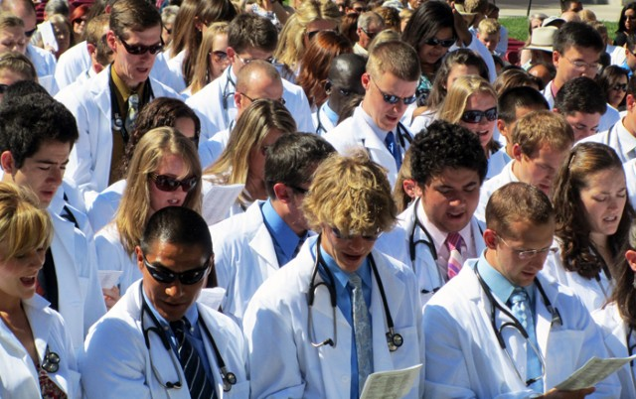
Medical School
Year 1
Year 2
Year 3
Year 4

Slide 19
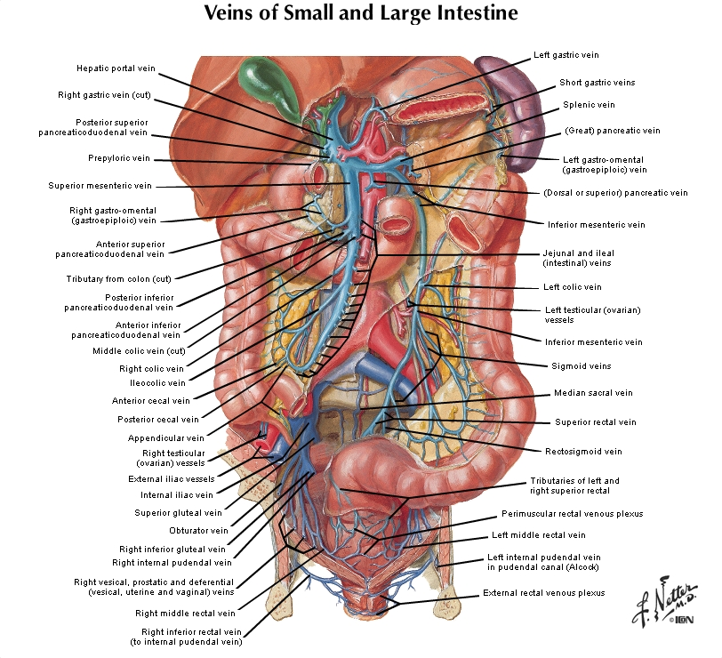
Medical School
Year 1
Year 2
Year 3
Year 4
Lectures
Anatomy
Molecular Biology
Immunology
Hematology
Cardiology
Pulmonology
Nephrology

Slide 20
Medical School
Year 1
Year 2
Year 3
Year 4
Lectures
Anatomy
Molecular Biology
Immunology
Hematology
Cardiology
Pulmonology
Nephrology

Slide 21
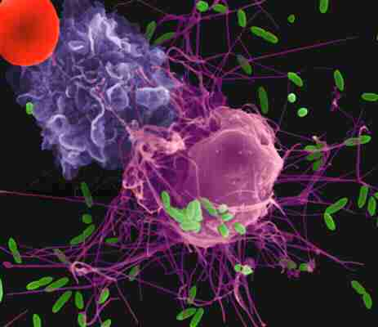
Medical School
Year 1
Year 2
Year 3
Year 4
Lectures
Anatomy
Molecular Biology
Immunology
Hematology
Cardiology
Pulmonology
Nephrology

Slide 22
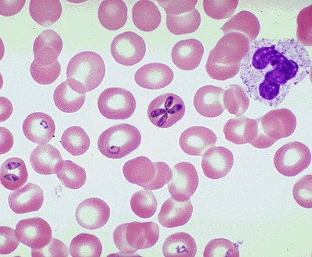
Medical School
Year 1
Year 2
Year 3
Year 4
Lectures
Anatomy
Molecular Biology
Immunology
Hematology
Cardiology
Pulmonology
Nephrology

Slide 23
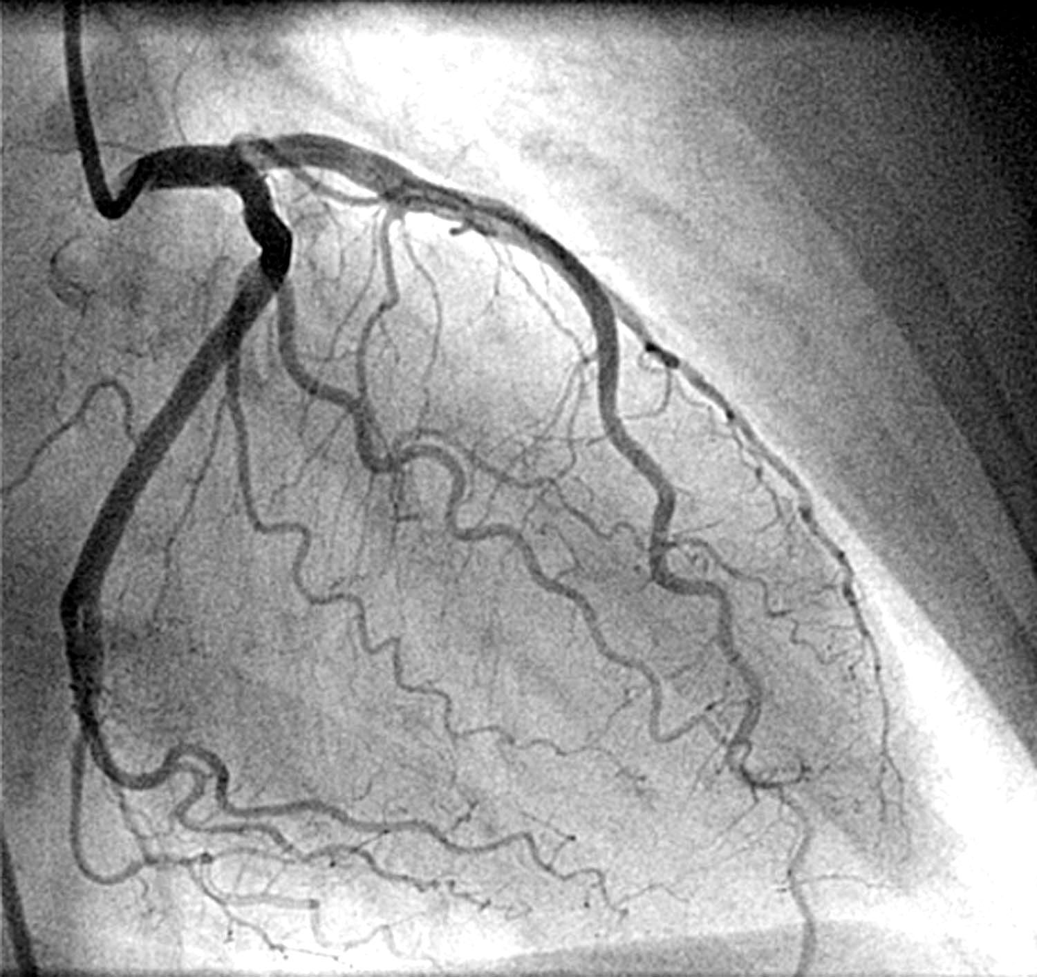
Medical School
Year 1
Year 2
Year 3
Year 4
Lectures
Anatomy
Molecular Biology
Immunology
Hematology
Cardiology
Pulmonology
Nephrology

Slide 24
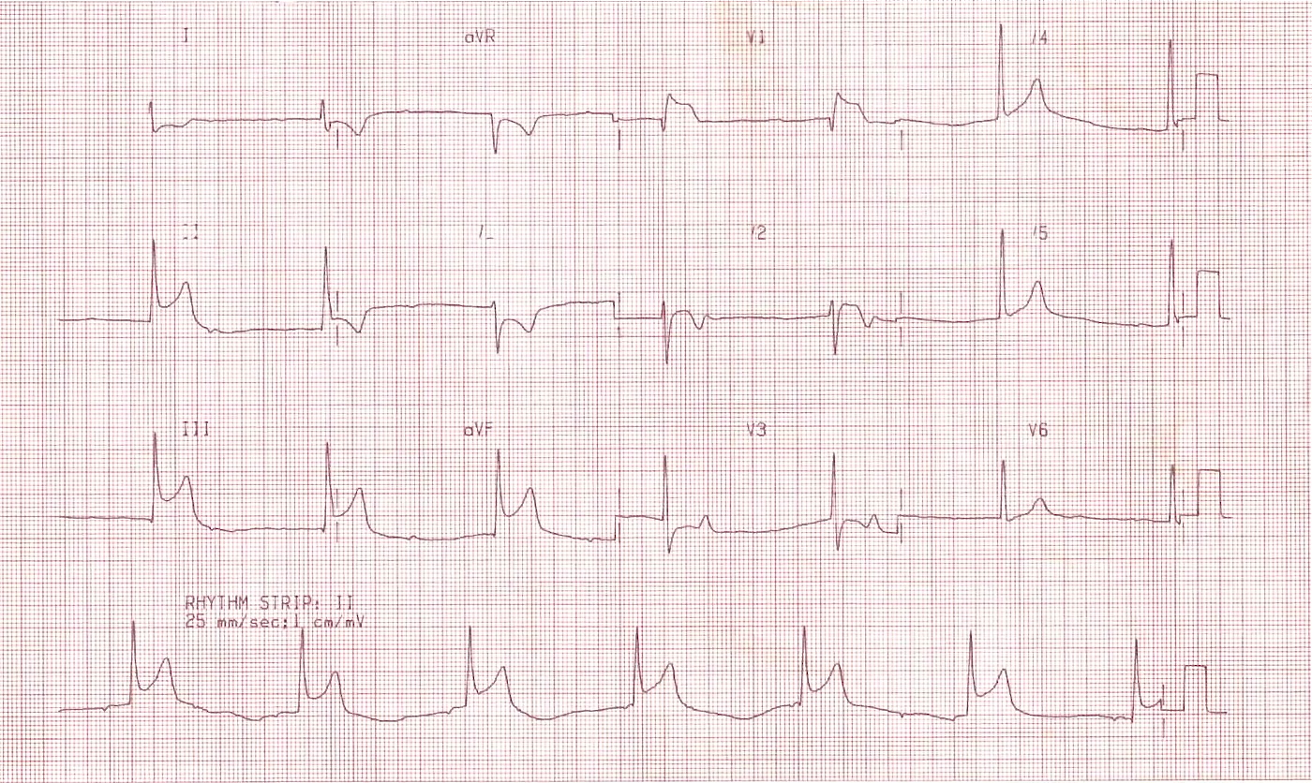
Medical School
Medical School
Year 1
Year 2
Year 3
Year 4
Lectures
Anatomy
Molecular Biology
Immunology
Hematology
Cardiology
Pulmonology
Nephrology

Slide 25
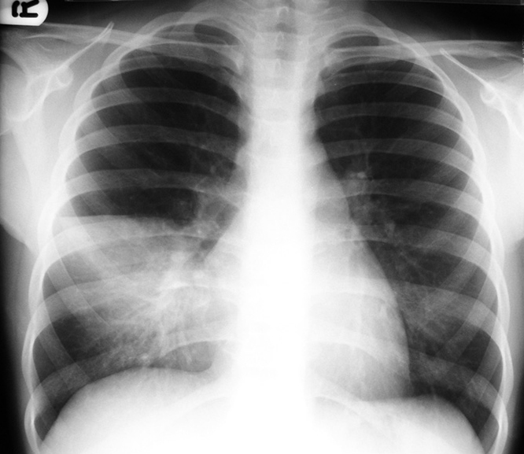
Medical School
Year 1
Year 2
Year 3
Year 4
Lectures
Anatomy
Molecular Biology
Immunology
Hematology
Cardiology
Pulmonology
Nephrology

Slide 26
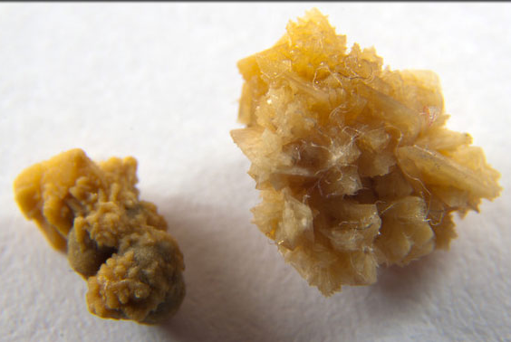
Medical School
Year 1
Year 2
Year 3
Year 4
Lectures
Anatomy
Molecular Biology
Immunology
Hematology
Cardiology
Pulmonology
Nephrology

Slide 27
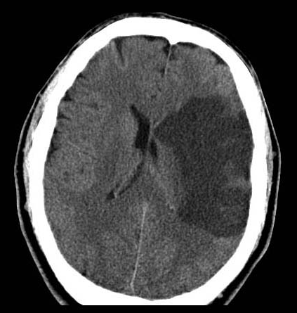
Medical School
Year 1
Year 2
Year 3
Year 4
Lectures
Neurology
Gastroenterology
Infectious Disease
Life Cycles
Psychiatry

Slide 28
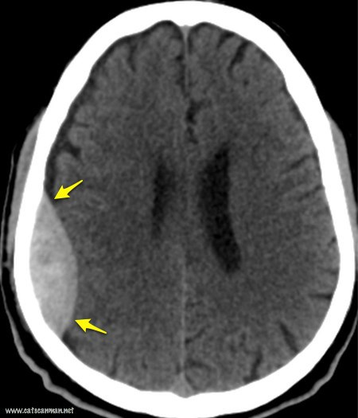
Medical School
Year 1
Year 2
Year 3
Year 4
Lectures
Neurology
Gastroenterology
Infectious Disease
Life Cycles
Psychiatry

Slide 29
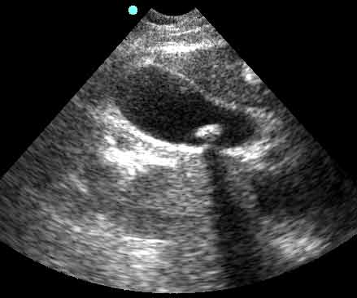
Medical School
Year 1
Year 2
Year 3
Year 4
Lectures
Neurology
Gastroenterology
Infectious Disease
Life Cycles
Psychiatry

Slide 30
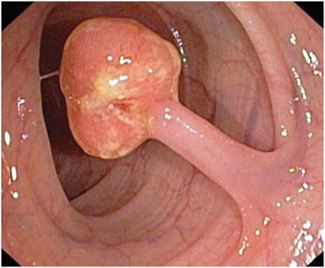
Medical School
Year 1
Year 2
Year 3
Year 4
Lectures
Neurology
Gastroenterology
Infectious Disease
Life Cycles
Psychiatry

Slide 31
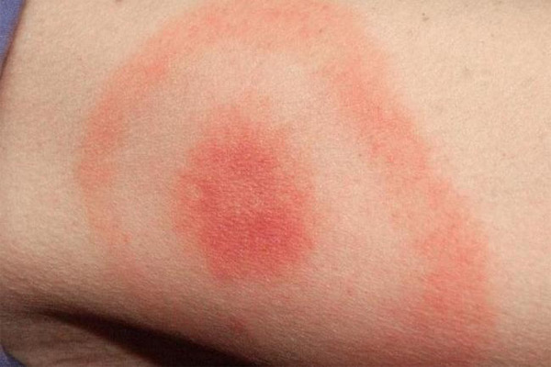
Medical School
Year 1
Year 2
Year 3
Year 4
Lectures
Neurology
Gastroenterology
Infectious Disease
Life Cycles
Psychiatry

Slide 32
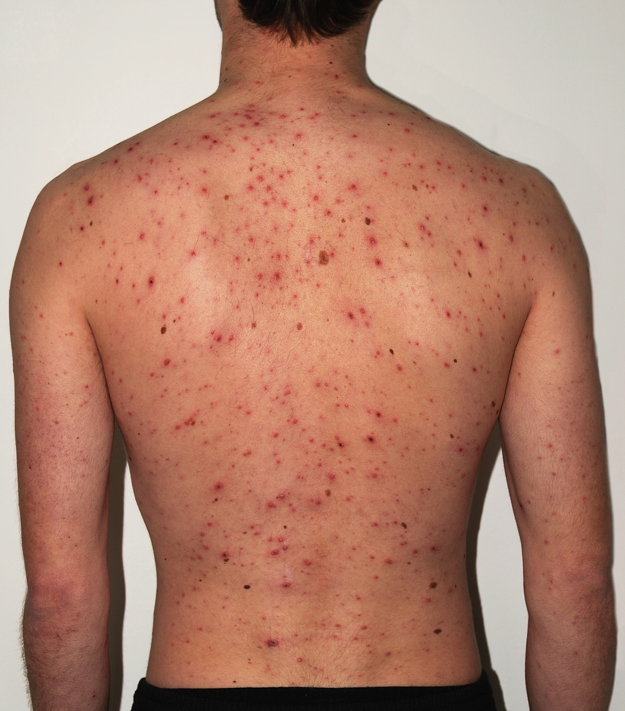
Medical School
Year 1
Year 2
Year 3
Year 4
Lectures
Neurology
Gastroenterology
Infectious Disease
Life Cycles
Psychiatry

Slide 33
Medical School
Year 1
Year 2
Year 3
Year 4
Lectures
Neurology
Gastroenterology
Infectious Disease
Life Cycles
Psychiatry

Slide 34
Medical School
Year 1
Year 2
Year 3
Year 4
Lectures
Neurology
Gastroenterology
Infectious Disease
Life Cycles
Psychiatry

Slide 35
Medical School
Year 1
Year 2
Year 3
Year 4
Clerkships
Internal Medicine
Surgery
Family Medicine
Emergency Medicine
Pediatrics
Women’s Health
Psychiatry
Neurology

Slide 36
Medical School
Year 1
Year 2
Year 3
Year 4
Sub-Internships
Subspecialties
Career Exploration
Apply for Residency
R&R

Slide 37
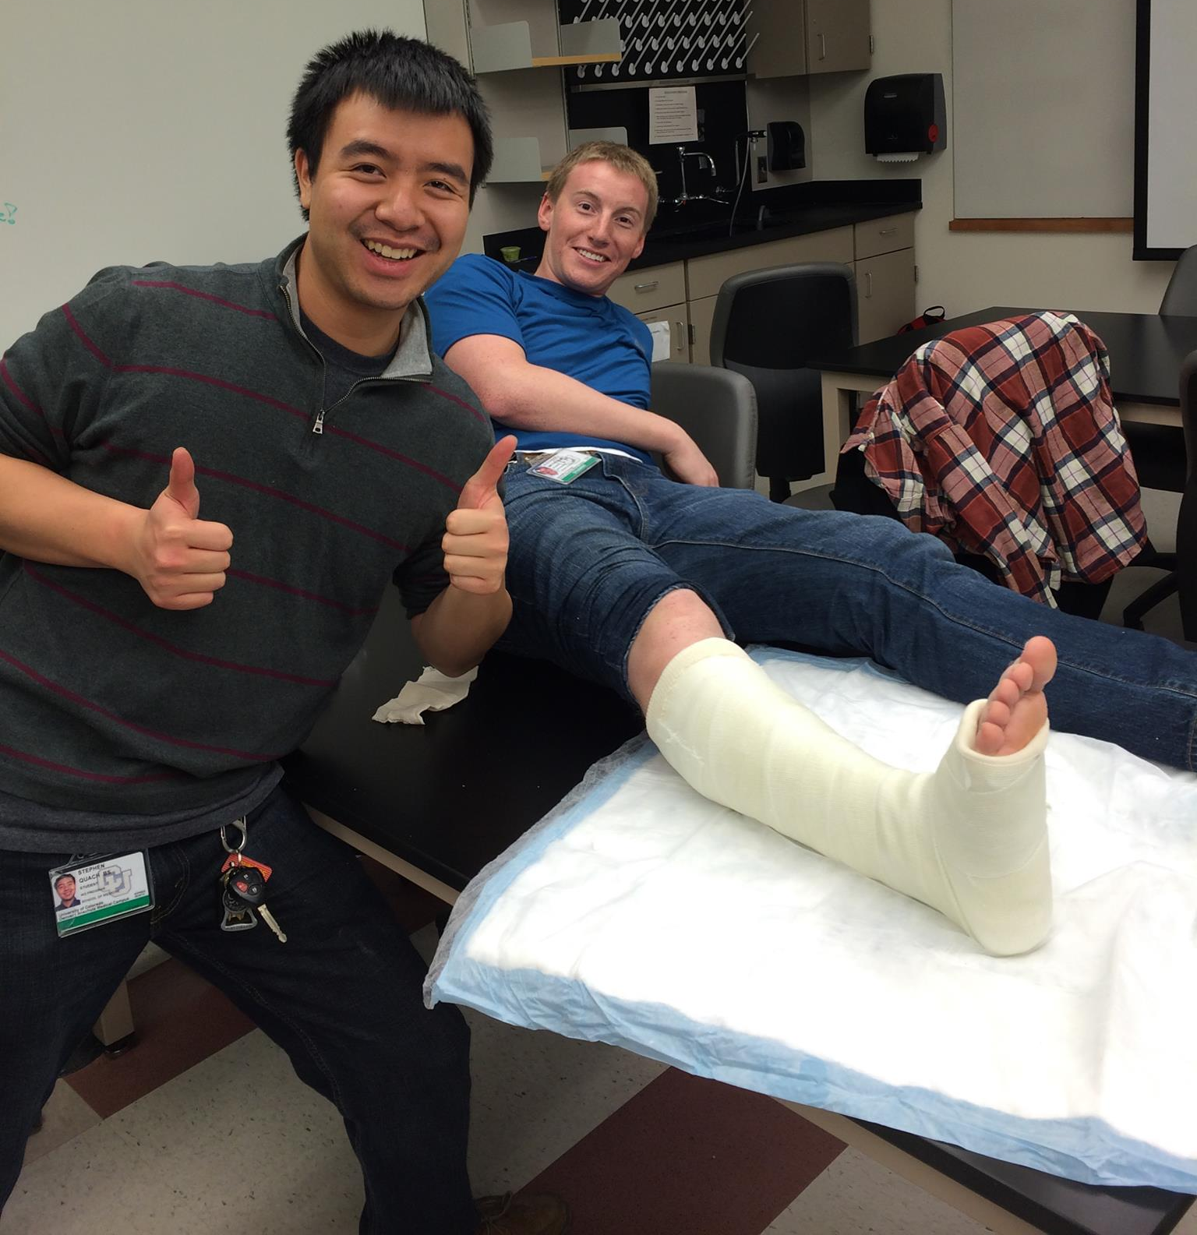
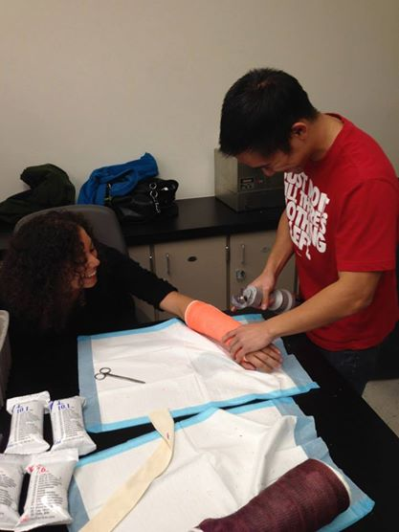
Clinical Workshops

Slide 38
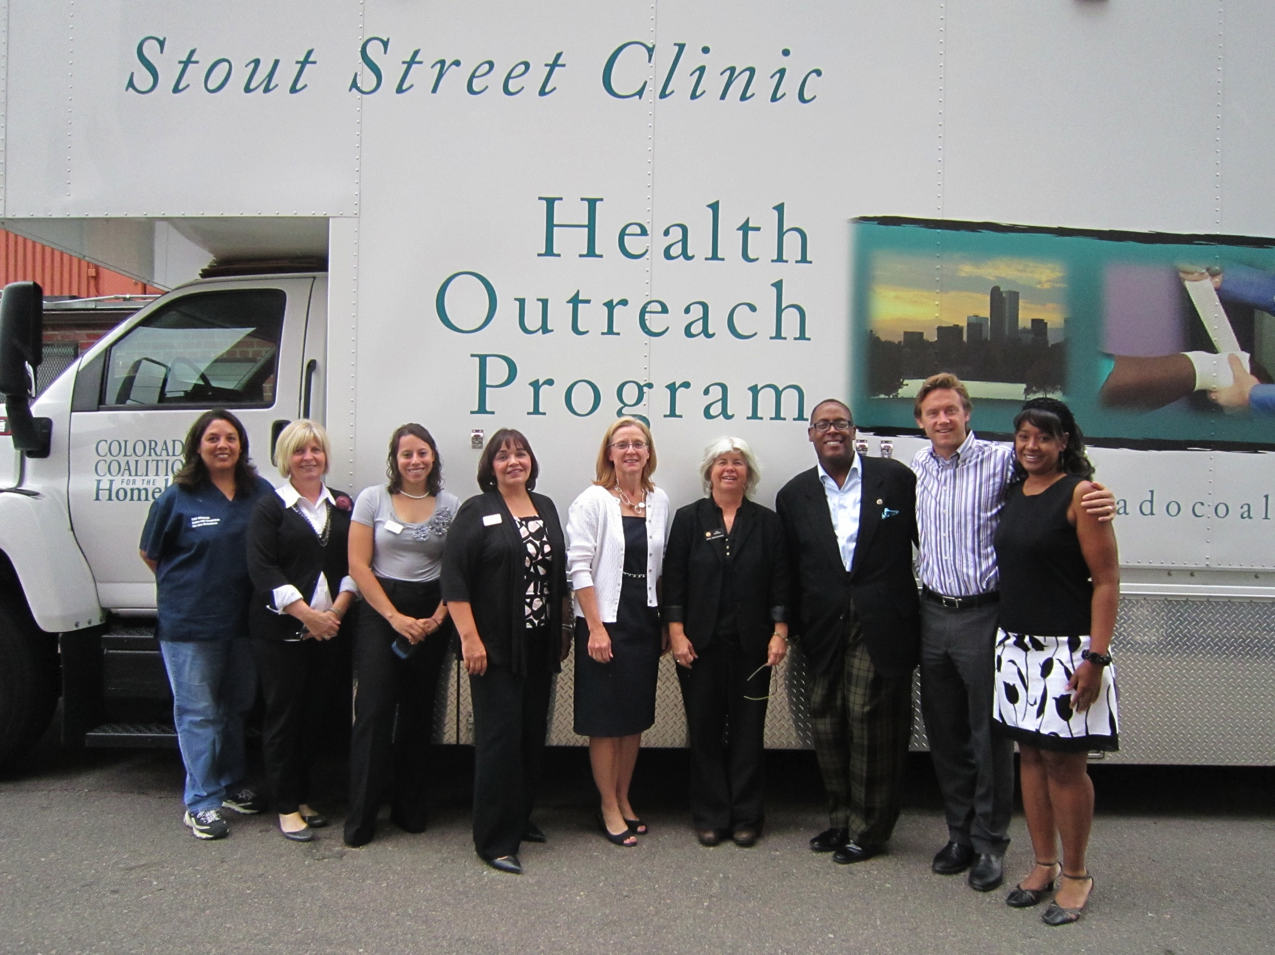
Work With Homeless

Slide 39
Work Abroad

Slide 40
Tracks
CU-UNITE (Colorado Urban Underserved Interprofessional Health Training and Education)
Global Health
LEADS (Leadership, Education and Advocacy Development Scholarship)
Research
Rural
Women’s Care

Slide 41
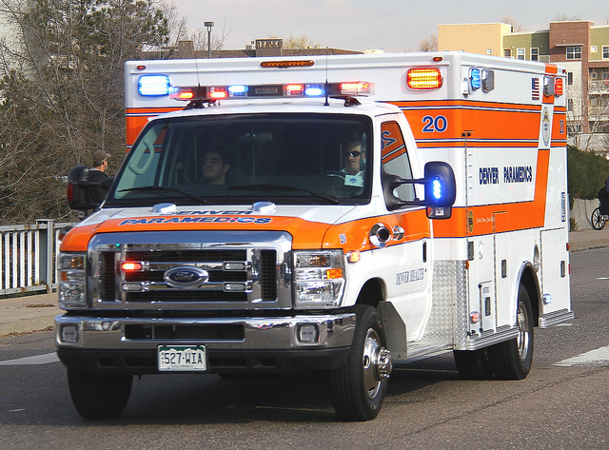
Ambulance Ride-Along

Slide 42
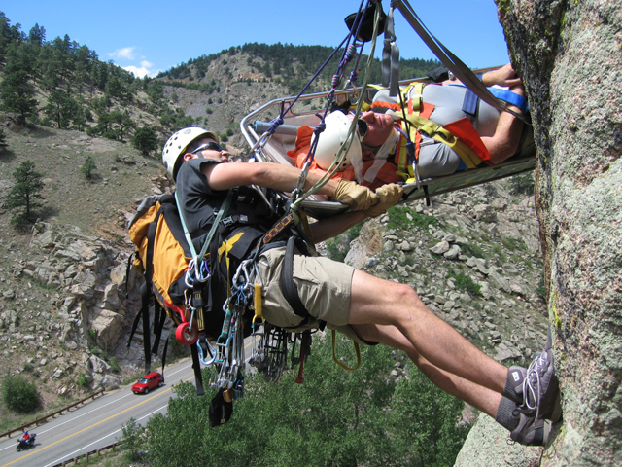
Rocky Mountain Rescue

Slide 43
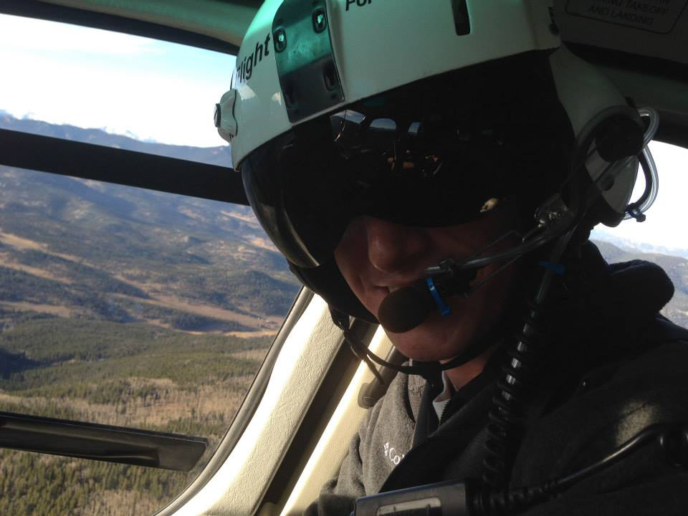
Flight For Life

Slide 44
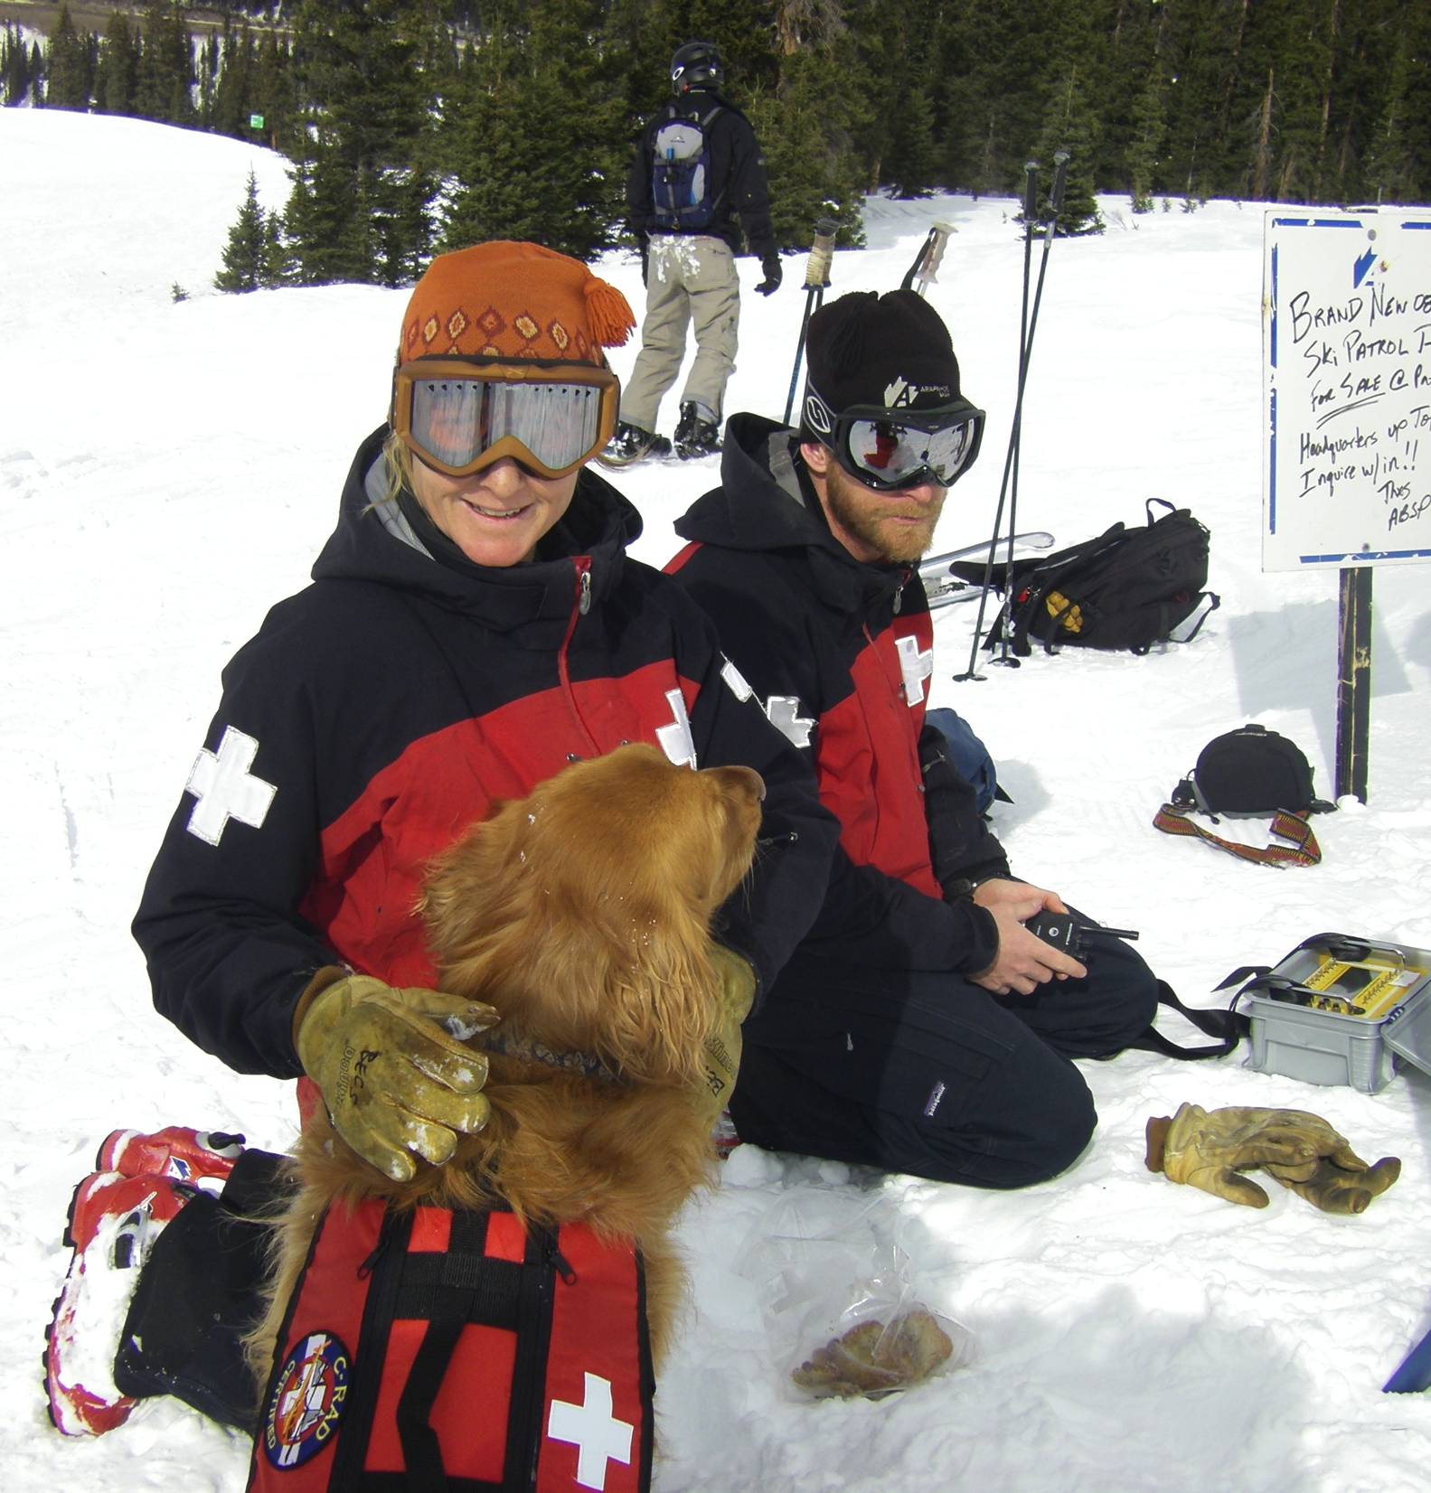
Ski Patrol

Slide 45
Skiing

